Slide 1
Predicting Women’s NCAA Basketball Scores
Martin Alonso and Jimmy Chen
IST707

Slide 2

Introduction
NCAA yearly March Madness competition
64 best teams play one play-off game each round to determine who will be the champion
Competition for both men and women – but we’ll focus just on the women’s teams.
We’ll try to predict the score of the winning team for each competition of the 2017 season.

Slide 3

Where we got the data
Kaggle 2017 March Madness competition
Data included information on the following:
Cities
Teams
Games – both Regular and Competition
What we added:
League points scored/allowed per season
Offensive and defensive ratings
Point spread
Models we used:
Linear Regression
Random Forest – it also does regressions!
Support Vector Machine
Data was split as follows:
2008 – 2016 training set
2017: testing set

Slide 4
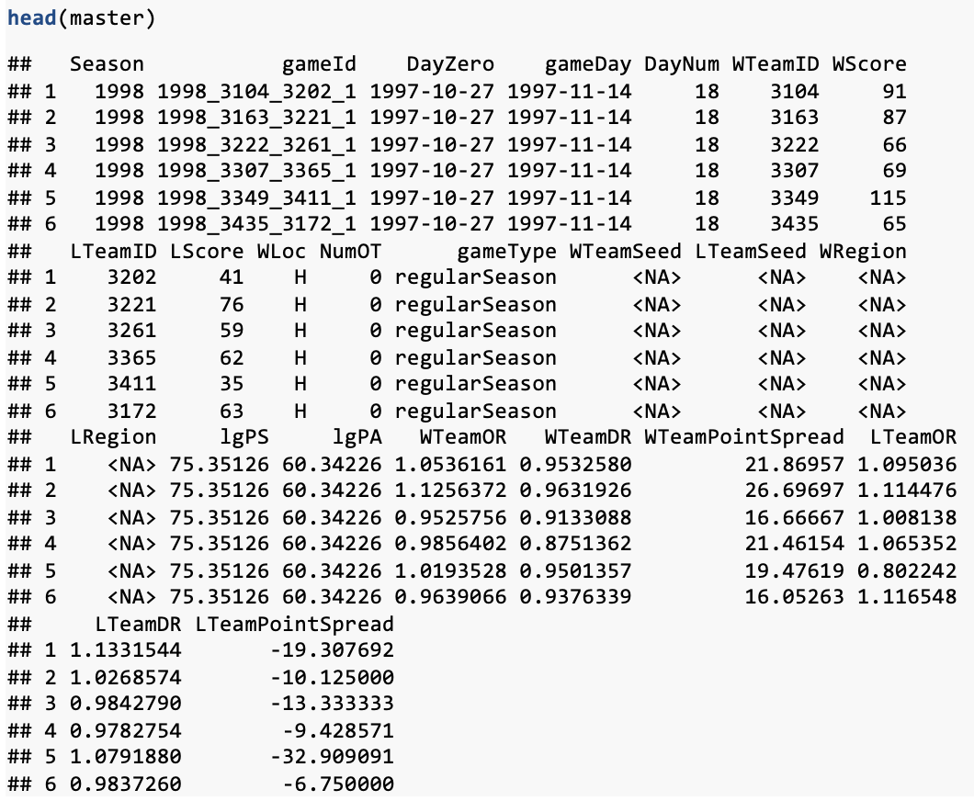
Master data frame

Slide 5
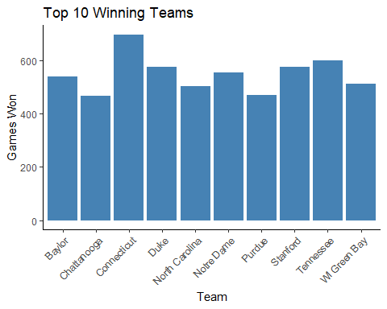
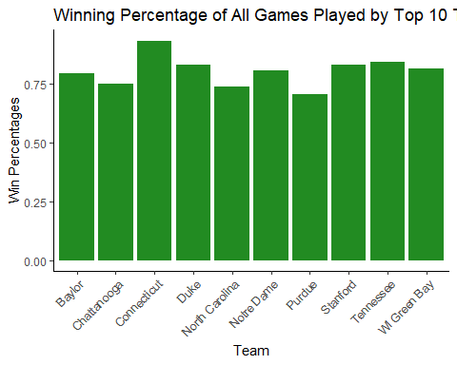
Who are the top teams?
We found the top 10 teams by total number of wins and found they all have over 50% winning record – makes sense!

Slide 6
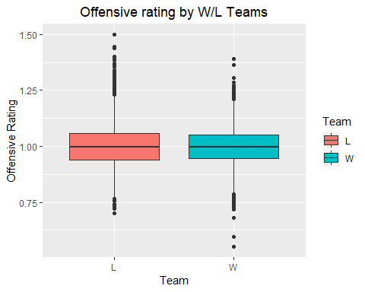
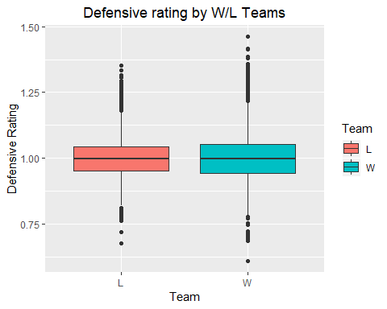
How do offensive and defensive ratings stack?
Based on the boxplots, the losing teams have a higher offensive rating while the winning teams have higher defensive rating
Which can speak truth of the old mantra: defense wins championships

Slide 7

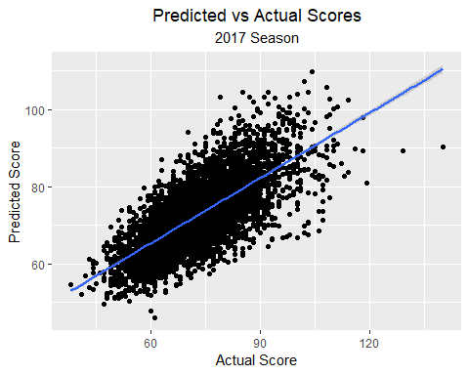
Linear Regression
To predict the winning team’s score, we used both winning and losing team ID codes, both teams offensive and defensive ratings, and both teams average point spreads.
Most influential variables:
Losing Team’s Defensive Rating: 9.75
Losing Team’s Point Spread: -8.26
Winning Team’s Offensive Rating: -6.39
Adjusted R-squared: 0.5339
RMSE: 7.89

Slide 8
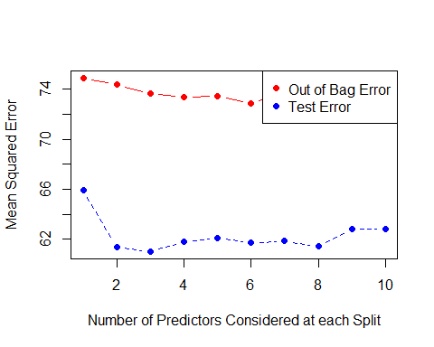
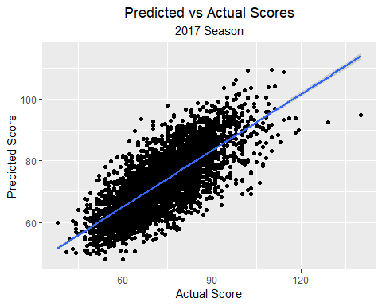
Random Forest
We used the same input variables and tuned the model using the best 6 variables after building 100 trees.
We found that the six best variables explain 55.15% of the variability.
RMSE imploved by 4% to 7.53!
Scores at the top end were tighter than the previous model.

Slide 9
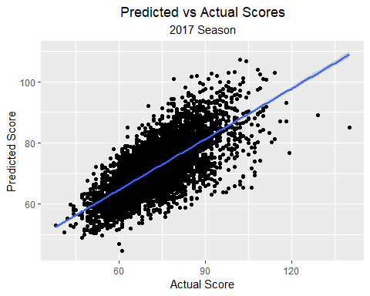
Support Vector Machine
SVM wasn’t as good at predicting the winning score but had an R-squared between the RF and LR.
R-Squared: 0.5331
RMSE: 7.96
We used a linear kernel and set it up as a regression model using 3 fold cross-validation.
Perhaps by calibrating both the gamma and cost parameters, we could’ve gotten a more accurate model.

Slide 10
Conclusions and after thoughts
The three models were successful predicting the winning score within a margin of error of 8 points!
But the Random Forest was the best as it predicted the score within 7.56 points.
Using league points scored and allowed, offensive and defensive ratings, and point spread, we could’ve tried to calculate expected points scored for both teams.
Seeing that we can predict scores within 8 points, it would be interesting to add expected points scored/allowed and predict whether the home team or the away team won.
Maybe in the future we could revisit this!

